Slide 1
2019-10-25 Lab meeting 2
黃彥鈞 (Weber, Huang)

Slide 2
Outline
AI cup
Data release survey : Harvard Data Verse

Slide 3
2019 AI cup

Slide 4
AI cup progress (1/2)
Data preprocessing
Word Embedding
ML & DL
Word segmentation :
NLTK, keras.preprocessing.text
TFIDF metrics
Keras.layers.embeddings
word2vec
Feature Engineering

Slide 5
AI cup progress (2/2)
ML model works
Classification Method :
SVM
Naïve Bayes
Decision Tree
Logistic Regression
Random Forest
XG Boost
Deep Neuron Network :
MLP
RNN
CNN
CRNN

Slide 6
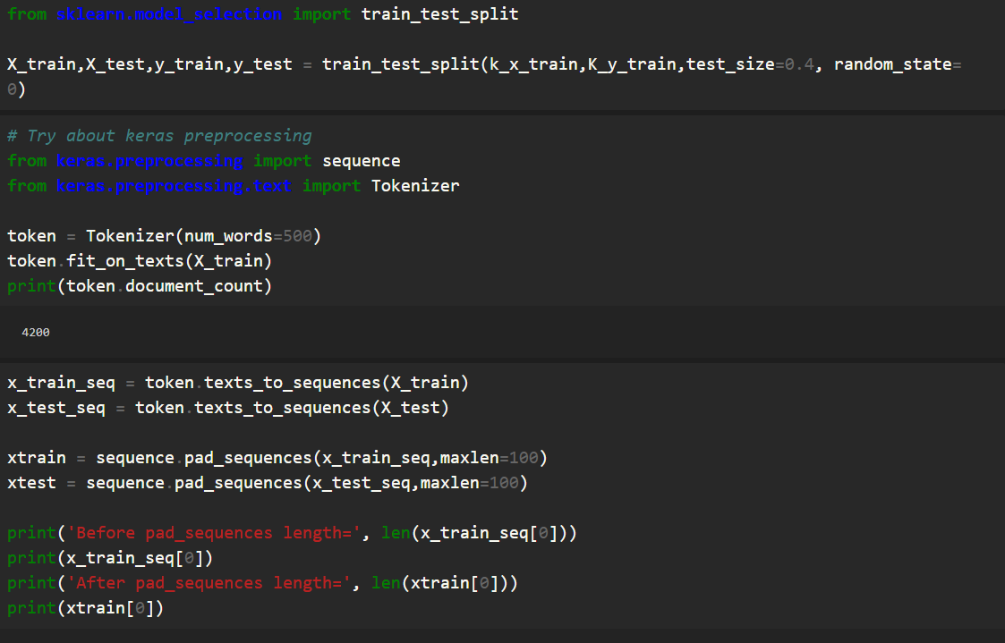
AI cup Model : MLP example (1/4)

Slide 7
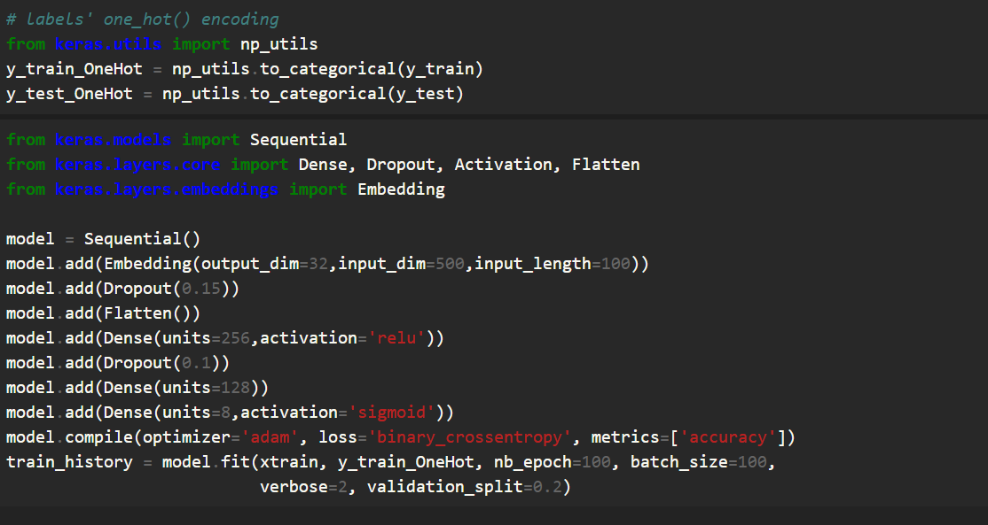
AI cup Model : MLP example (2/4)

Slide 8
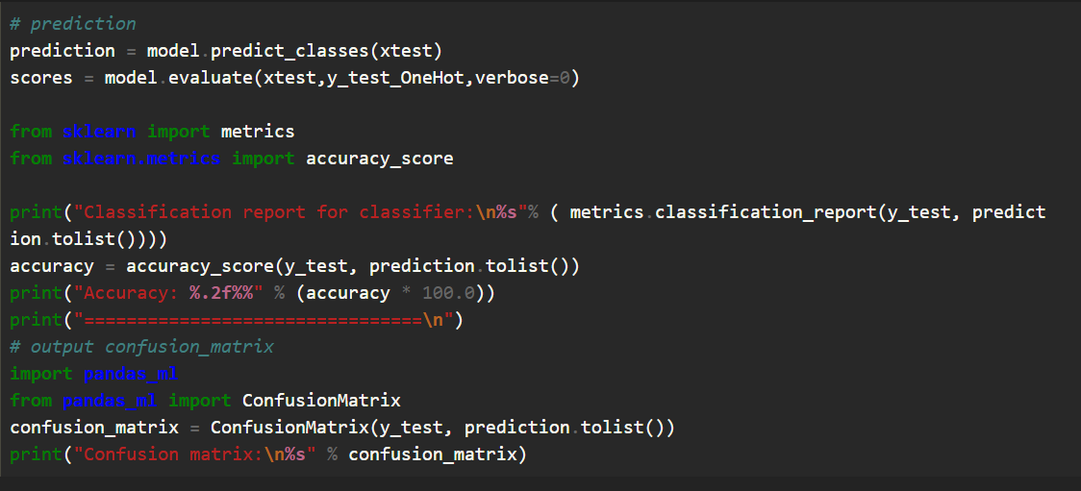
AI cup Model : MLP example (3/4)

Slide 9
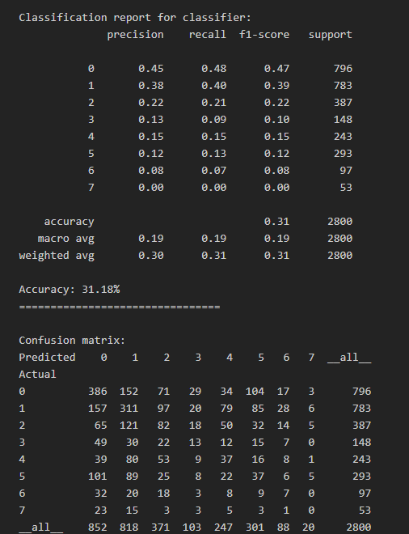
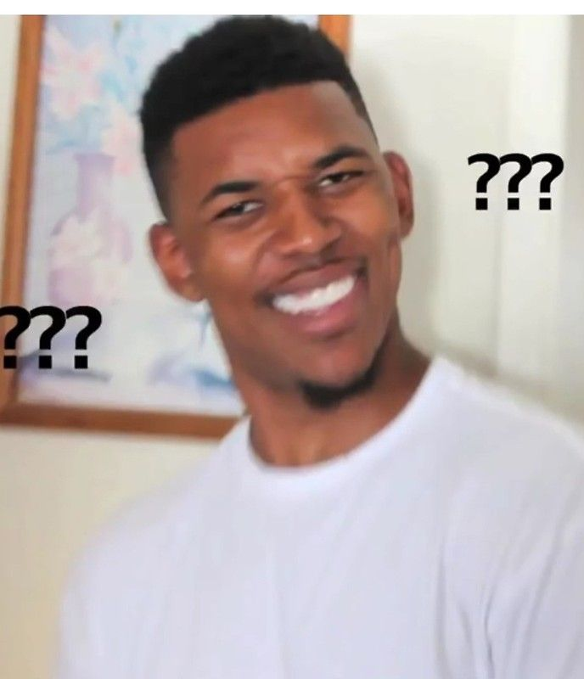

AI cup Model : MLP example (4/4)
Adjust the parameter
Try out another DNN model

Slide 10
Next week’s goals
Upload submission to leaderboard
Finish trying every model
Additional, Go on to feature engineering

Slide 11
Data release survey Harvard Dataverse

Slide 12
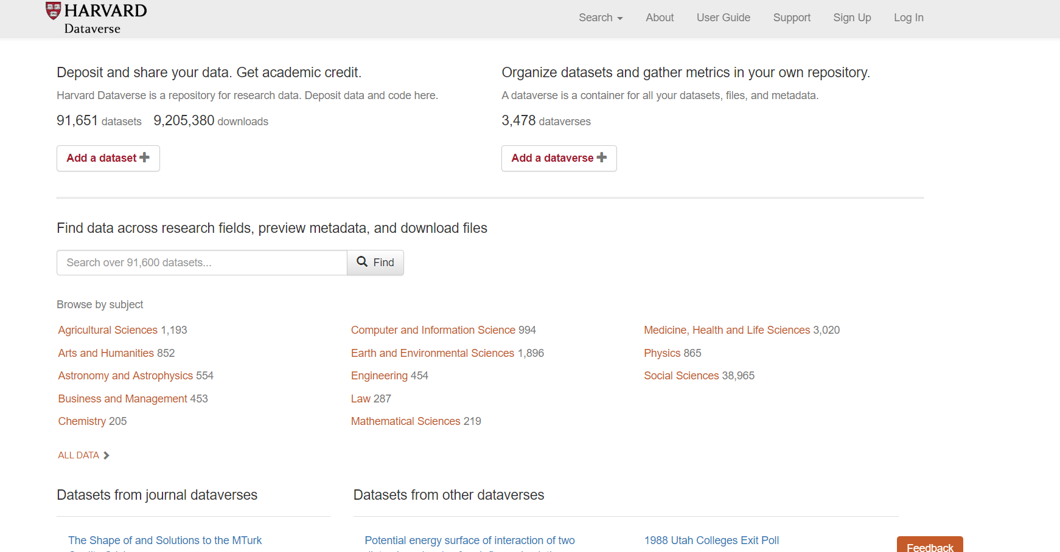
Harvard Dataverse
A collaboration with the Institute for Quantitative Social Science (IQSS), the Harvard Library, and Harvard University Information Technology (HUIT):
the Harvard Dataverse is a repository for sharing, citing, analyzing, and preserving research data. It is open to all scientific data from all disciplines worldwide.

Slide 13
The licensing of dataset release (1/3)
By default, all new datasets created through Dataverse’s web UI are given a Creative Commons CC0 Public Domain Dedication.
Additional restrictions, conditions, and terms can still be compatible with CC0, as CC0 only operates in the realm of copyright, which is rather limited when it comes to data.
If a data owner feels that CC0 is not suitable for their data, they are able to enter custom Terms of Use.
Yes
Applying CC0
If CC0 is suitable for their data?
Data Releasing
Custom Terms of Use
No

Slide 14
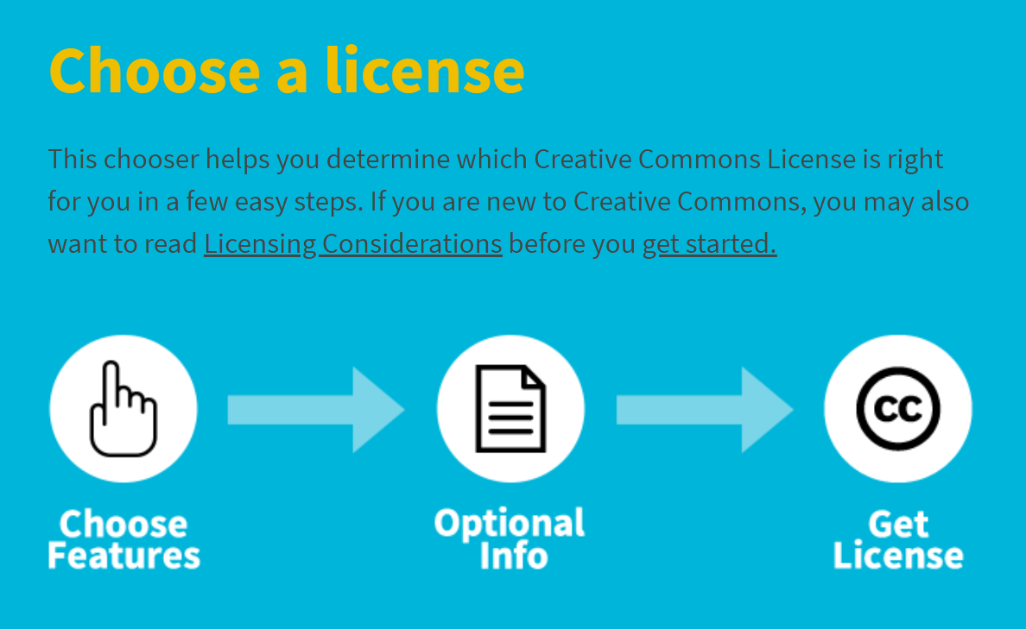

The licensing of dataset release (2/3)
Every license helps creators — we call them licensors if they use our tools — retain copyright while allowing others to copy, distribute, and make some uses of their work — at least non-commercially.
Allow adaptations of your work to be shared?
Allow commercial uses of your work?

Slide 15
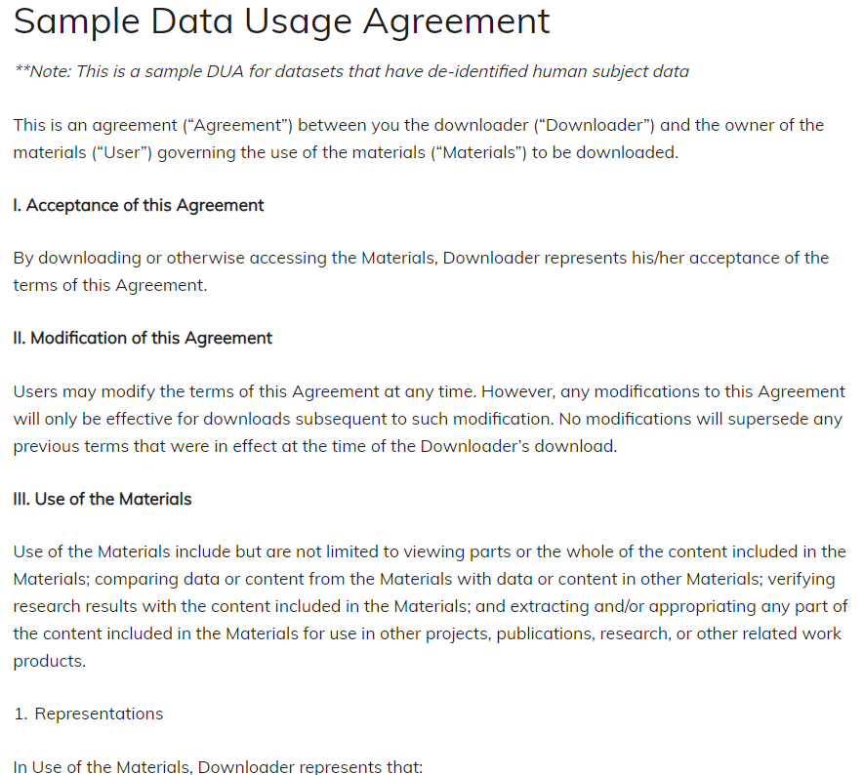
The licensing of dataset release (3/3)
To add more information about the Terms of Use, we have provided fields like Special Permissions, Restrictions, Citation Requirements, etc.
Example of data usage agreement
Restrict files in dataset

Slide 16
Thanks for listening !!!

